Slide 1
Silver linings: How COVID-19 expedited differentiated service delivery for HIV
Peter Ehrenkranz, MD, MPH
Bill & Melinda Gates Foundation
Peter.Ehrenkranz@gatesfoundation.org

Slide 2
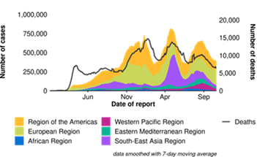
The remarkable and continuing toll from COVID-19
In the rush to return to normal, use this time to consider
which parts of normal are worth rushing back to.”
– Dave Hollis, author
WHO, Oct 20, 2021

Slide 3
“Silver linings” on the path to person-centered HIV services
Virtual support on mobile phones can accelerate ART initiation and facilitate monitoring in facilities and communities
Expanded concept of eligibility for less intensive models to include people with as little as 6m on ART, children <15 and those on second-line regimens
Extended ART refill durations (and maybe extended duration between clinical visits) to 6+ months should be a new standard of care

Slide 4
“Silver linings” on the path to person-centered HIV services (cont’d)
COVID-19 has emphasized the importance of expanding access to community-based services
DSD for HIV is also relevant in more highly resourced settings
DSD is applicable for HIV prevention and other vertical programs

Slide 5
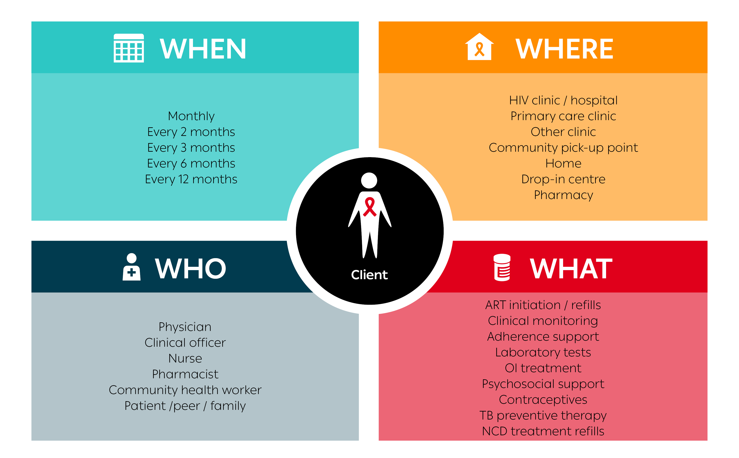
Building blocks of service delivery
Notes:
All of these services can benefit from the core concepts of differentiated service delivery: the separation of clinical visits from refill visits and a reconsideration of where, when and by whom different types of services should be provided, be they in-person interactions, telemedicine or postal deliveries.

Slide 6
DSD Research/evaluation priorities
Routine evaluations + implementation science studies:
  Virtual support for adherence and documentation?
  Earlier access to less intensive models for more people?
    Annual clinical visits?
    Annual refill visits?
  How to support re-engagement in care?
  How to differentiate models for delivering PrEP?
  How to integrate of DSD among HIV and other vertical programs?
Key indicators
  Clinical outcomes, individual and HCW experience, costs to patient and health system
Notes:
To further advance the trend to person-centered or self-care, we need evaluations of routine data, quality improvement collaboratives, and focused implementation science studies on the themes that I’ve described in these slides:
To what extent can virtual support using mobile phones to encourage adherence and provide documentation of engagement as clinical and refill visits become less frequent?
Should anyone be restricted from access to less intense models of ART delivery? PBFW
Are annual clinical visits sufficient for people established on ART?
How soon after initiating ART should PLHIV become eligible for multimonth refills?
What is the ideal duration of a multimonth refill? Could it be annual also?
Differentiated models for prevention
Coordination of HIV treatment services with other vertical programs - FP, TB, NCDs– especially their supply chain and M+E systems.

Slide 7
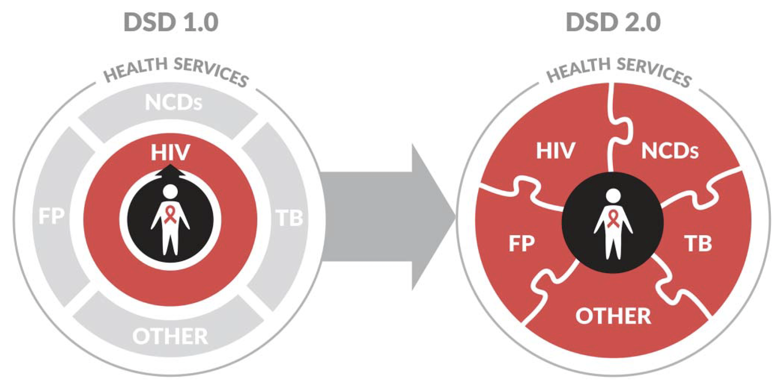
More “Silver linings” to come?
Ehrenkranz, et al. JAIDS, 2021.
Notes:
In the end, these shifts may indeed represent a silver lining to the pandemic—a further acceleration of the trend towards rethinking how health care is delivered to provide high quality person-centered care- for people living with HIV, as pictured in the middle of the circle on the right, but also, eventually, for people regardless of HIV status.

