Slide 1
Supporting PrEP access for female sex workers in Zimbabwe during COVID-19 lockdown with community-based delivery, extended PrEP refills and virtual support during COVID-19 lockdown
Primrose Matambanadzo, Joanna Busza, Haurovi Mafaune; Lillian Chinyanganya; Fortunate Machingura; Getrude Ncube; Richard Steen; Andrew Phillips; Frances Mary Cowan
Primrose Matambanadzo
Chief of Party - USAID Closing the Gaps: Accelerating and sustaining HIV prevention and care for sex workers
Programme Director – Key Populations
Centre for Sexual Health and HIV/AIDS Research (CeSHHAR) Zimbabwe
primrose@ceshhar.co.zw

Slide 2
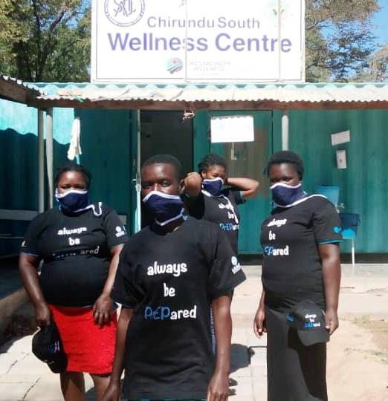
Background
Sisters with a Voice
Sex worker led comprehensive sexual and reproductive health services for sex workers
Established in 2009 with 61 sites across all 10 provinces in Zimbabwe
>26 000 sex workers seen at Sisters’ clinics in 2020
PrEP programme
2016: MoHCC adopts WHO guidelines to include oral PrEP
2018: Implementation Plan for HIV Pre-Exposure Prophylaxis in Zimbabwe 2018-2020
2019: Sisters with a Voice commences PrEP initiations for sex workers

Slide 3
Methodology
Hypothesized that peer-led community-based provision of PrEP services influenced both demand and supply of PrEP uptake
Data collected from all female sex workers receiving services within Sisters at facilities and within the community
Included aggregated anonymized individual clinic data
  19,407 female sex workers who presented to Sisters and tested negative in 2020, including 6,539 female sex workers who initiated on PrEP during 2020
Mapped PrEP uptake among all female sex workers who tested negative at Sisters in 2020 (divided into four periods)
  Prior to lockdown (January-March 2020)
    During severe restrictions (April-June 2020)
    Subsequent to easing of restrictions (July-September 2020)
    During the time of drug stockouts that followed (October-December 2020)

Slide 4
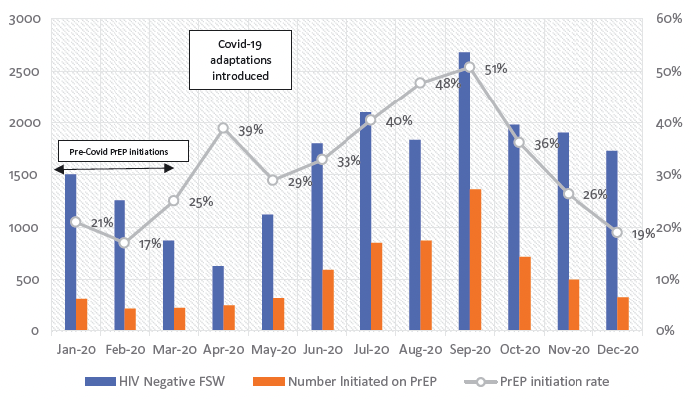
Results (1)
Sisters PrEP initiation rate, 2020
Before COVID-10, PrEP uptake occurred at rates <25% among female sex workers testing negative at Sisters
Beginning May 2020, PrEP uptake increased monthly peaking at an initiation rate of 51% (n=1,360) in September 2020
Unexpected rise in demand coincided with national commodity shortages between October and December 2020
In 2020, 19,407 sex workers tested negative and were screened for PrEP, of 33.7% (n=6,539) initiated PrEP
  Highest initiations among sex workers aged 20-24 years at 33% (2152/6539)

Slide 5
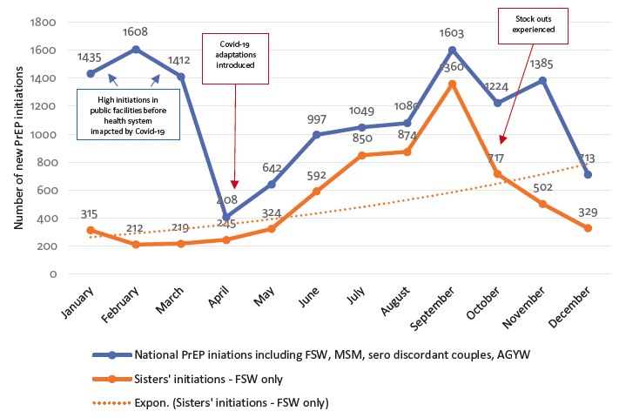
Results (2)
National and Sisters only PrEP initiations, 2020
Sisters contribution increased to 63% between April and December 2020, compared with a contribution of 16% between January and March 2020 prior to adaptations within Sisters.
Retention at one month was 40% (n=2,269), 27% (n=1,509) at three months and 14% (n=803) at six months (PrEP continuation data was only available for 5653 SW)

Slide 6

Adaptations to PrEP programme in 2020 in response to COVID-19
PrEP screening, initiation and early follow-up (0-3 months)
PrEP continuation (+3 months)
Screening
PrEP initiation visit
Initial follow-up
PrEP refill
Routine clinical follow-up
At entry point, first clinic/DIC visit
First visit
One month visit, virtual follow up at 1 week for side effects/adverse events
Every 3 months if tolerating well
Every 3 months, SW receive virtual support for monthly check ins
Clinic
Drop in centre
Community
Clinic
Drop in centre
Community
Clinic
Drop in centre
Community/home
Clinic
Drop in centre
Community/home
Clinic
Drop in centre
Community/home
Nurses, outreach teams
Nurses, outreach teams
Nurses, outreach teams
Nurses, outreach teams
Nurses, outreach teams
Counselling on combination HIV prevention, HIV testing, eligibility screening, adherence counselling
Counselling on combination HIV prevention, adherence, STI, ARV side effects, eligibility screening
Counselling on combination HIV prevention, adherence, STI, ARV side effects, HIV testing
Counselling on combination HIV prevention, adherence, STI, ARV side effects, testing every 3 months
Counselling on combination HIV prevention, substantial risk screening adherence, assess for signs of of acute HIV, STI, ARV side effects

Slide 7
Summary of adaptations to PrEP in 2020
DSD for PrEP was scaled up during COVID-19 with increasing interest in and uptake of PrEP among sex workers
Empowered community cadres to educate peers and create demand for PrEP
Increased number of PrEP access points with teams of a clinician, outreach worker, community cadre – to deliver community-based PrEP services
Scaled up of telehealth with support for side effects and adherence counselling provided via phone and WhatsApp
Increased virtual peer support through WhatsApp broadcast lists and groups to addresses PrEP myths, encourage uptake and adherence, and check concerns
Enabled multi-month dispensing (MMD) of PrEP with PrEP refills provided for three months at a time, waiving the initial requirement for monthly clinic visits

Slide 8
Strengths and limitations
Greater risk perception by sex workers during COVID-19 may also have increased sex workers’ openness to PrEP as an alternative prevention strategy
Lower mobility during COVID-19 lockdowns with inter- and intra-city travel restricted, sex workers were unable to migrate out of Zimbabwe or move between locations in search of work.

Slide 9
Next steps
Adapted PrEP distribution model remains in place in 2021 -> identify lessons for future implementation and potential relevance to other settings following commodity supply restoration
Document the peer-led, community-based PrEP service delivery model -> effective and adopted for long-term use
Improve quality of service and support provided
Improve continuation rates

